Slide 1

Opening New restaurant in London, UK

Slide 2

The basis of this study is to help a small group of investors planning to open their first Indian restaurant expansion in London.
They are interested in building in an area that meets the following criteria:
1. A neighborhood with an average to above average total population
2. above average populations of 25–40-year-old male and female professionals
3. A high concentration of the population having secondary education
4. Average to above average median net household incomes

Slide 3

With the help of the dataset present in the official UK website (https://opendata.camden.gov.uk/resource/tr8t-gqz7.json) using the ward name ,Ward codes we will be creating the dataframe.
With the help of Foursquare API we will identify the venues, ratings of the Indian restaurants.
“https://data.london.gov.uk/download/country-of-birth/c61439c3-32ab-4c7d-941e-366d4ac2c57c/cob-borough.xls” file help us to identify the population of different countries.

Slide 4

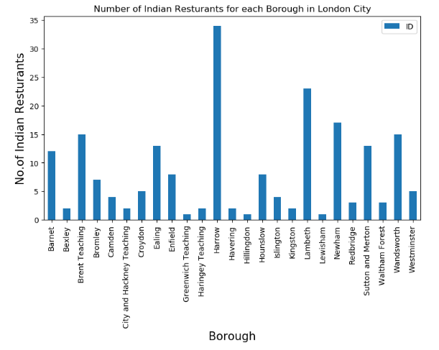

Slide 5

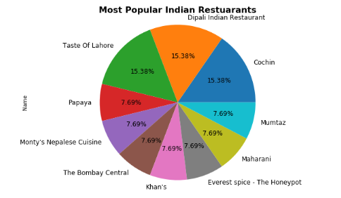
Based on the popularity of the restaurants below pie chart shows the most rated Indian restaurants in London/

Slide 6

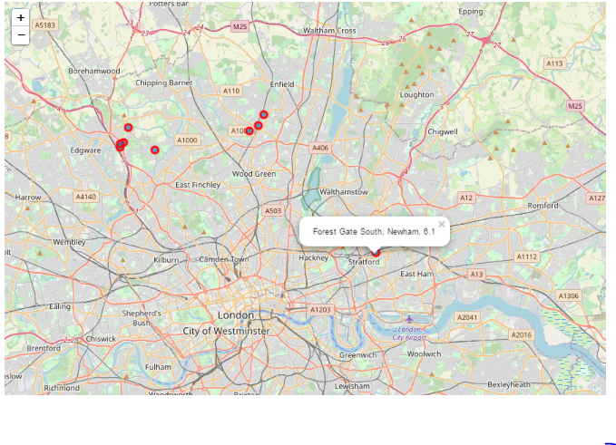

Slide 7

Newshaw Borough is the better location as per analysis, which has more South Asian population than other boroughs with average rating of Indian restaurant is 6.1 .
By calculating existing restaurant ratings and population density in different neighborhoods from Foursquare data we have first identified general boroughs that justify further analysis , and then generated extensive collection of locations which satisfy some basic requirements regarding existing nearby restaurants.

